Slide 1
Chapter 14
Electronic Commerce, Databases, and Personal Privacy

Slide 2
Learning Objectives (1 of 2)
Explain the issues, pros, and cons of whether to create an ecommerce website.
List the components of online transactions, and explain what is involved in each step.
List one other ecommerce model besides the online retailer selling to the general public and explain how it works.
List one other electronic payment system besides traditional credit cards and explain how it works.

Slide 3
Learning Objectives (2 of 2)
Describe the relational database model
Frame simple queries in SQL to retrieve information from one or more tables in a relational database
Define data mining
List three sources data brokers use to collect data on individuals
Give an example of data science used "for the greater good"

Slide 4
Introduction
The World Wide Web enables businesses to communicate with customers through:
Advertising
Follow-up support
Sales to consumers
Sales to other businesses
Non-sales transactions (statements and bill pay)

Slide 5
Ecommerce (1 of 16)
Ecommerce: business conducted with the Internet and via the web including sales, advertising, and bill pay options
Setting up an organization for ecommerce can be as intensive as setting up a physical store front.
What business problem are you solving?
Broadening the customer base
Recapturing customers lost to online competitors
Serving existing customers better
Integrating departments of existing business

Slide 6
Ecommerce (2 of 16)
Risks of moving online
Same customers moving from in-store to online
Facing new competition online
Existing customers don’t need/want online store
Employee concerns
Costs of moving online
Computer equipment and infrastructure
Hiring personnel to manage the website
Legal expertise required to protect your intellectual property, regulations online, and customer privacy

Slide 7
Ecommerce (3 of 16)
Ecommerce decisions:
Design website in-house or hire an ASP (Application Service Provider)
Buy or lease equipment
Use existing software or have custom software written

Slide 8
Ecommerce (4 of 16)
Customer transaction overview
Customer learns of your site and goes there
Identify return customers and personalize the site
Provide a secure environment for making purchase
Process the payment
Communicate with accounting and credit company
Order fulfillment
Update inventory
Contact shipping system and shipping company
Arrange pick up and delivery to customer

Slide 9
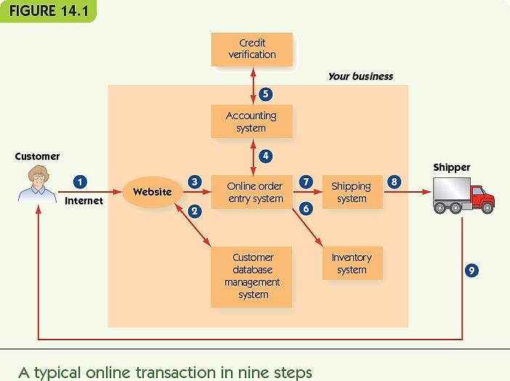
Ecommerce (5 of 16)

Slide 10
Ecommerce (6 of 16)
How do customers learn about your site?
Conventional print advertising with URL
An obvious domain name (home page URL)
ICANN (Internet Corporation for Assigned Names and Numbers) registers domain names
Search engine results (sponsored link)
Presence on a portal (website about a topic) with links to retail, wholesale, and informational websites

Slide 11
Ecommerce (7 of 16)
Identify return customers and personalize the site
Require the user to register and log in
Connects to the database with the user’s past history on the site
Leave a cookie on the user’s computer
Small text file containing information about the user
Allows continuity between one page of a site and another
(Relatively) harmless

Slide 12
Ecommerce (8 of 16)
Provide a secure environment for making a purchase
Encryption: ensure sensitive information is encrypted for transmission
Authentication: verify that your website is legitimate

Slide 13
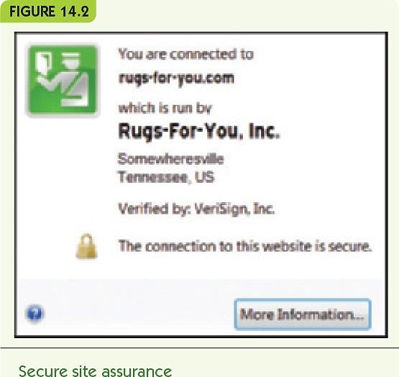
Ecommerce (9 of 16)

Slide 14
Ecommerce (10 of 16)
Process payment
Option 1: while the customer waits
Online form communicates with accounting software
Accounting system verifies customer credit
Customer can correct bad information
No need to keep credit card numbers
Option 2
Record the order and payment information
Verify and complete the transaction offline
Send mail confirmation to the customer

Slide 15
Ecommerce (11 of 16)
Fulfill the order
Communicate with online inventory
Reduce item counts for purchased items
Arrange for shipping
Online shipping system
External shipping company
Arrange pick-up at the warehouse and delivery to the customer

Slide 16
Ecommerce (12 of 16)
Website design: overall
Attractive with new products displayed
Good design principles
Organize for natural shopping habits
Make it easy to navigate
Provide site map or navigation bar
No more than four clicks from one page to another
Encourage browsing and targeted searching
Ensure the site works on different platforms and browsers

Slide 17
Ecommerce (13 of 16)
Website design: purchase
Provide electronic “shopping carts”
Checkout steps that:
Always show details of order
Clearly indicate what the next button click does
Allow the customer to go back and change things
Give the customer shipping options
Provide email with order information and shipping confirmation

Slide 18
Ecommerce (14 of 16)
Website design: other information
Clear privacy policy
FAQ page and link to customer service
Entries allowed for customer reviews or forums
Form to subscribe to a newsletter
Suggestion box
News and press releases

Slide 19
Ecommerce (15 of 16)
Multiple software systems must communicate
Website, customer accounting, inventory, and shipping
Suppliers, orders, and billing
Personnel
Legacy code: existing old software still in use
Middleware: software to enable separate systems to communicate
Disaster recovery strategy: response to natural disasters, equipment failures, or being hacked

Slide 20
Ecommerce (16 of 16)
Other ecommerce models
eBay: peer-to-peer auction-style sales
Craigslist: peer-to-peer classified ads
Groupon: group coupons
Businesses post coupons for one day only
Minimum number required
PayPal: online payment service
Bitcoin: virtual currency

Slide 21
Databases (1 of 15)
Databases store large amounts of data
Businesses require databases for:
Inventory, personnel, customers, suppliers, and financials
Data organization
Bits and bytes: basic pieces of computer data
Field: one meaningful piece of information
Record: a set of related fields
Data file: a set of related records
Database: a set of related data files

Slide 22
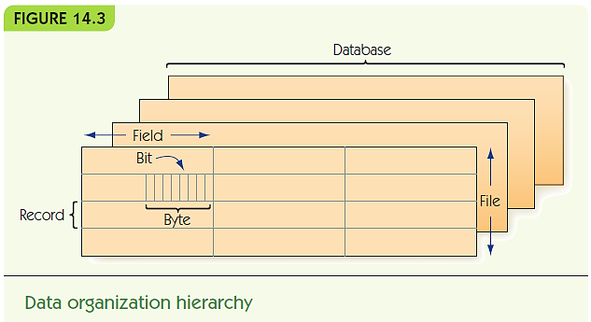
Databases (2 of 15)

Slide 23
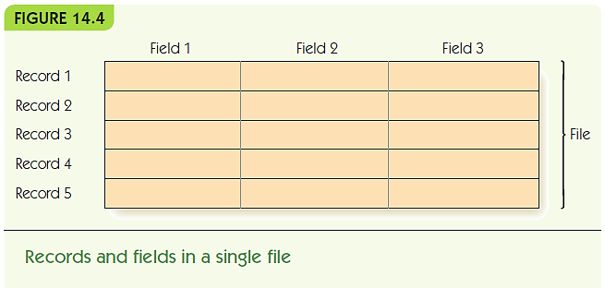
Databases (3 of 15)
Data files are represented as tables
Records are rows; fields are columns

Slide 24
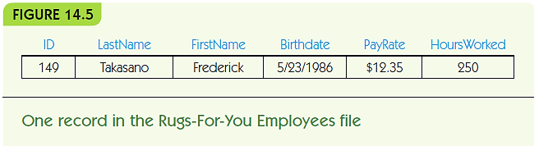
Databases (4 of 15)
Rugs-for-You: example of an employee record
Record = one employee
Each field has:
A field name (a category) with a specific data type
A value in the field for the selected record (employee)

Slide 25
Databases (5 of 15)
Database management system (DBMS)
Manages files in a database
Relational database model: files are 2-d tables
Entity: a distinguishable component of system
Example: an employee, a customer, or a rug for sale
Tuple: a row of a relational table
Attribute: category of a field
Primary key: attribute(s) that uniquely identify a tuple

Slide 26
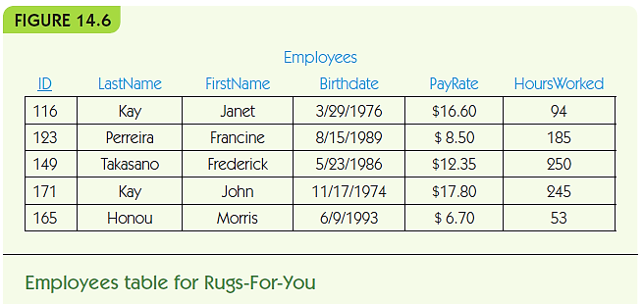
Databases (6 of 15)

Slide 27
Databases (7 of 15)
SQL (Structured Query Language)
Standard query language for DBMS
Use SQL queries to retrieve data according to some criteria
Example 1: retrieve employee name, pay rate, and hours worked for employees named Perreira

Slide 28
Databases (8 of 15)
SELECT ID, LastName, FirstName, Payrate, HoursWorked
FROM Employees
WHERE LastName = ‘Perreira’;
SELECT *
FROM Employees
ORDER BY ID;
SELECT *
FROM Employees
WHERE PayRate > 15.00

Slide 29
Databases (9 of 15)
Example 2: retrieve all employee records, sorted by ID number
SELECT *
FROM Employees
ORDER BY ID;
Example 3: retrieve records of employees who are paid more than $15.00 per hour
SELECT *
FROM Employees
WHERE PayRate > 15.00

Slide 30
Databases (10 of 15)
Multiple tables may contain related data
Example: insurance policies for Rugs-for-You
Foreign key: an attribute in one table that is the key in another
Connects data in one table with another
Example: EmployeeID

Slide 31
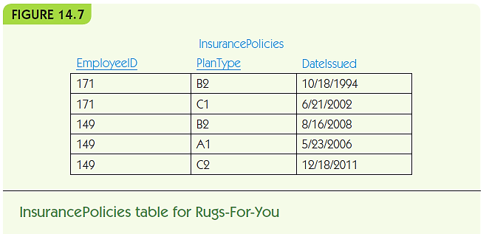
Databases (11 of 15)

Slide 32
Databases (12 of 15)
Multi-table example
SELECT LastName, FirstName, PlanType
FROM Employees, Insurance Policies
Where LastName = ‘Takasano’
AND FirstName = ‘Frederick’
AND ID = EmployeeID;

Slide 33
Databases (13 of 15)
Relational database operations
Project: pick some attributes from a set of tuples
SELECT LastName, FirstName, PlanType
FROM Employees, Insurance Policies
Restrict: pick tuples that meet criteria
WHERE LastName = ‘Takasano’
AND FirstName = ‘Frederick’
Join: combine tuples from different tables
FROM Employees, Insurance Policies
…
AND ID = EmployeeID;

Slide 34
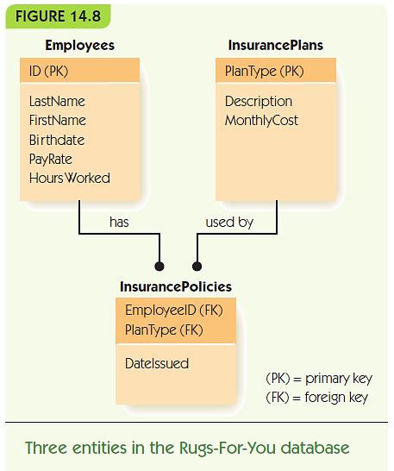
Databases (14 of 15)

Slide 35
Databases (15 of 15)
Database integrity: verification as data is added/removed
Entity integrity: no primary key can be missing
Data integrity: values must match category constraints (e.g., be a valid pay rate)
Referential integrity: foreign keys must match a primary key value in the related table
Efficiency: disk defragmentation and other measures to maintain efficient access
Distributed database: data stored across a computer network

Slide 36
Personal Privacy
Privacy issues associated with data mining
Automatically analyzing large amounts of data to uncover hidden patterns
Data warehouse: collection of databases
Data brokers: companies that collect and sell data such as:
Birth certificates, marriage certificates, publically available information, and nonpublic data purchased or acquired from other companies or data brokers.

Slide 37
Summary (1 of 2)
Ecommerce is a central part of our economy
Businesses deciding to enter the online world must plan carefully
Ecommerce web design is complicated
Ecommerce requires integrating multiple computer systems: inventory, accounting, suppliers, etc.
Databases are systems to store large amounts of data
Data is organized into fields, records, data files, and databases

Slide 38
Summary (2 of 2)
DBMS manages files of databases
The relational database model is the most common: records represent entities; all data is viewed as sets of 2-d tables
SQL is the most common query language for retrieving data from a DBMS
Databases must ensure integrity, efficiency, and (sometimes) distributed access to data
Privacy issues arise due to data mining techniques

